Slide 1
Five Specific Ways to Write Effective Python
Gabriel Colenso

Slide 2

Item 13: “Prefer Catch-All Unpacking Over Slicing”
Relying on indexing to unpack remaining values in a list that aren’t assigned to variables can be visually noisy.
Use starred expressions to unpack all remaining variables that haven’t been unpacked

Slide 3
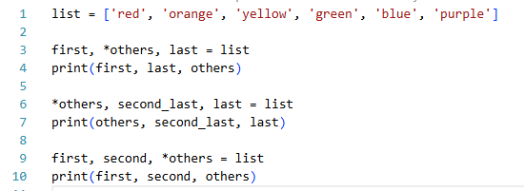
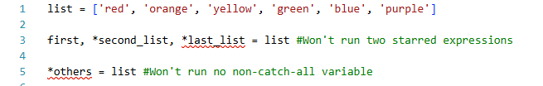
Item 13: “Prefer Catch-All Unpacking Over Slicing” cont.
Starred expression can appear in any position but must contain at least non-catch-all variable from a sequence.
Multiple catch all expressions in a single unpacking expression, is also not allowed.

Slide 4
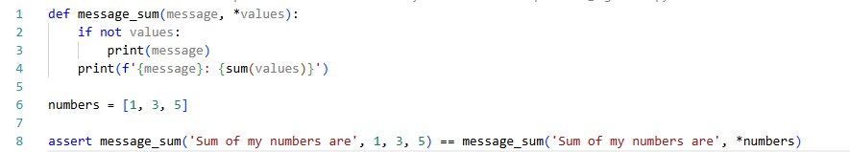
Item 22: “Reduce Visual Noise with Variable Positional Arguments”
Use of star args, via the * operator allows for a variable number of positional arguments in a function.
* operator works similarly to unpacking expressions, where ordering of star operator matters:

Slide 5
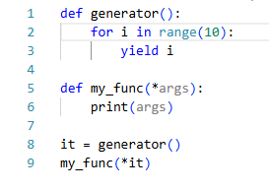
Item 22: “Reduce Visual Noise with Variable Positional Arguments” cont.
While these variable positional arguments reduce noise and excess code has some notable drawbacks:
  Using this operator on generators (which tend to prevent large sequences being stored in memory), unpacking this can cause crashes.
  Ordering of positional arguments matters and can cause bugs that are hard to spot as arguments are less verbose.

Slide 6
Item 70: “Profile Before Optimizing”
Profilers measure the runtime of the programme.
Two Python profilers available, pure Python profiler ‘profile’ and C-extension ‘cProfile’.
‘cProfile’ preferred as its overhead has less impact on runtime skewing the results of the profile.

Slide 7
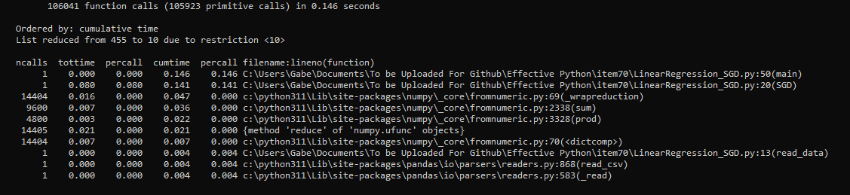
Item 70: “Profile Before Optimizing” cont.
Example:
Using this its clear the SGD function in the programme is the main bottleneck and can be focused on for optimisation of this code.

Slide 8
Item 80: “Consider Interactive Debugging with pdb”
While print statements can help to track down bugs in programmes the use a debugger can be more powerful.
Debugger allows for the programme to stop on the line desired in the script, allowing for local variables to be accessed.
Python debugger allows for breakpoints to be called in locations to stop running.
For bugs that occurs in unknown location, post-mortem debugging allows for the programme to automatically stop once it has hit a problem.

Slide 9
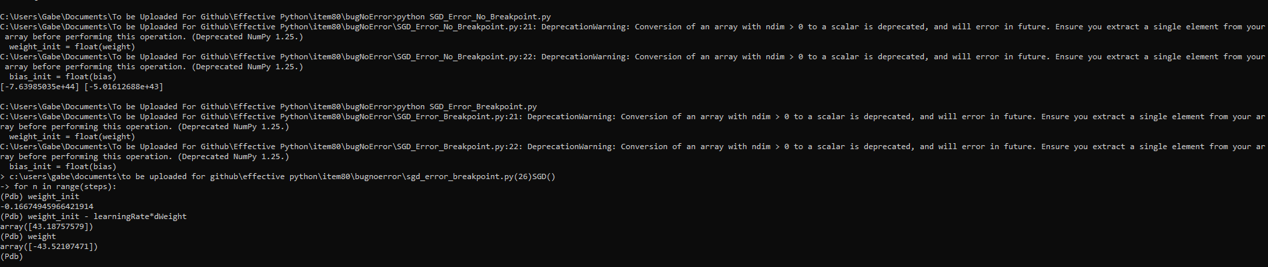
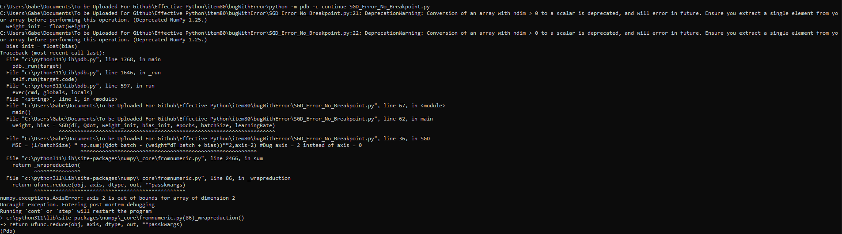
Item 80: “Consider Interactive Debugging with pdb” cont.
Example using breakpoints:
Example of post-mortem debugging:

Slide 10

Item 85: Use Packages to Organize Modules and Provide Stable APIs
As a codebase gets larger it’s expected that modules will be split into smaller various modules.
Packages in Python allow for this functionality, done via putting an empty __init__.py file in a directory containing scripts to be imported.

Slide 11
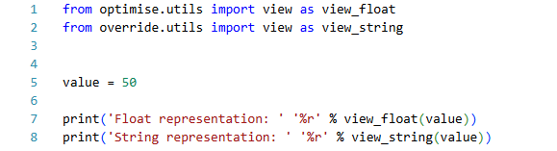
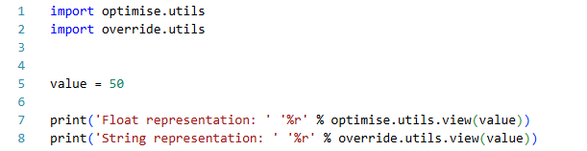
Item 85: Use Packages to Organize Modules and Provide Stable APIs cont.
Packages allow to divide modules with the same name into separate modules.
In this case the examples below shows how this can be done:

Slide 12
Item 85: Use Packages to Organize Modules and Provide Stable APIs
Packages also useful for stable APIs, where hiding code from external users is important.
This can be done via the use of __all__, if this special attribute is present in the code being imported, all the attributes assigned to __all__ are imported when calling import *.
A better way of doing this is by calling __all__ in the __init__.py file, which then becomes the contents of the package imported.

